Slide 1
DevOps Introduction by Amit Vashist
Notes:
Welcome to Puppet Fundamentals.
Now before we get into what Puppet is and what it can do, let's talk about the need for Puppet. In my day-to-day work, I implement and manage a lot of different systems. I've got Linux and Windows servers, databases, web applications, Citrix, VMware, and so on. Now regardless of whether you have a similarly diverse environment or a very uniform one, keeping up with the configurations of your systems and applications can be challenging, and this is where Puppet comes in.

Slide 2
Table of Content
Software Development Lifecycle
Waterfall vs Agile
Agile Manifesto
Scrum roles, artefacts and ceremonies
Agile vs DevOps
DevOps - extension of Agile
What is DevOps ?
DevOps Values
DevOps Benefits
DevOps Tool Chain
2

Slide 3
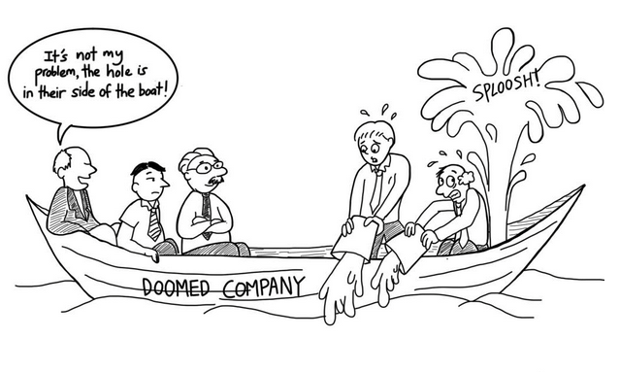
It’s not my problem !
3

Slide 4
Software Delivery Life Cycle (SDLC)
Requirements
Analysis
Design
Coding
Testing
Deployment
Maintenance

Slide 5












Software Development Lifecycle
Gather Business requirements from stakeholders like -
Who is going to use the system?
How will they use the system?
What data should be the input to the system?
What data should be output by the system?
System Support
User Support to resolve actual problems
Warranty Support / One month support
Requirement Gathering & Analysis
Output : Requirement Specification Document
Maintenance
Design
Prepare system and software design from the requirement specifications like :
Overall system architecture
High Level Design
Detailed Design
Interface Design
Deployment done in stages
Deployment in pre- production and production environment
Formal release of product in market
SDLC
Deployment
Coding
Coding of modules / units
Unit testing and code reviews
Coding guidelines followed
Longest phase of the cycle
TTeessttiinngg
Testing against the requirements
Functional testing like integration testing, system testing, acceptance testing
Non-functional testing like performance
testing, security testing
4

Slide 6
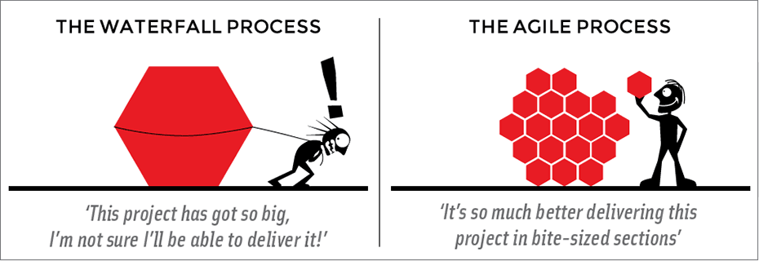
SDLC Methodologies
Benefits of Agile :
Potentially shippable product after each iteration
Less Risk and
uncertainty
Reduced cost of fixing issues
Agile is a time boxed,
iterative approach to software delivery,
that builds software incrementally from the start of project,
instead of trying to deliver it all at once, near the end

Slide 7
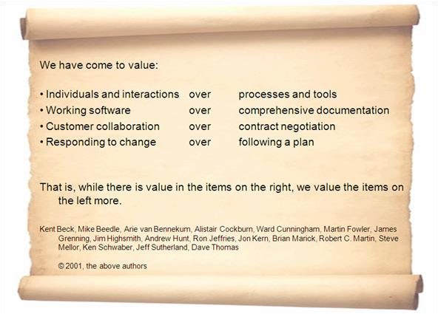
Agile Manifesto
6

Slide 8
Agile Evolution
Continuous Integration
Continuous Delivery

Slide 9

Developers Vs Testers
How can I break it?
How can I make it?

Slide 10
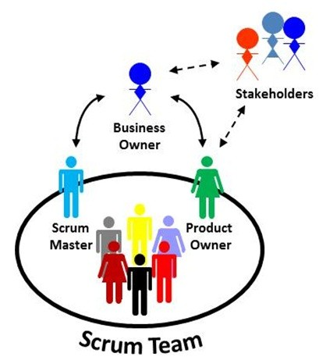
Developers + Testers!

Slide 11
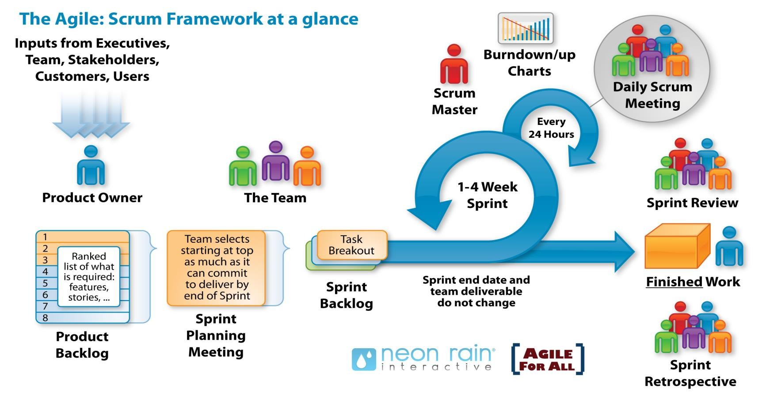
Scrum
7

Slide 12
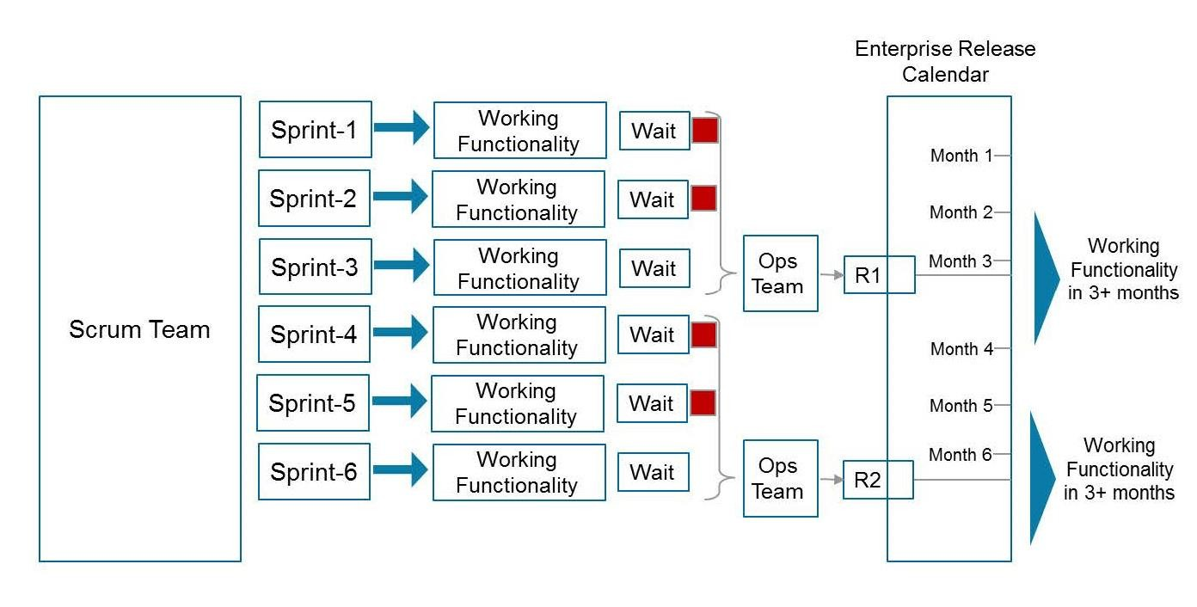
Agile vs DevOps
In an Agile scenario, a working functionality developed at the end of each sprint , may have to wait until the release date arrives.
Even on the release date, release of functionality might get delayed if :
the Ops team is not prepared for integration & deployment OR
the business is not ready to Go live with the new functionality
Shorter time to market -- a key benefit of Agile -- is not fully realized
DevOps is a model that is being adopted by many IT organizations to address the scenarios described below :
9

Slide 13
DevOps Evolution
Continuous Delivery
Continuous Deployment & Monitoring

Slide 14
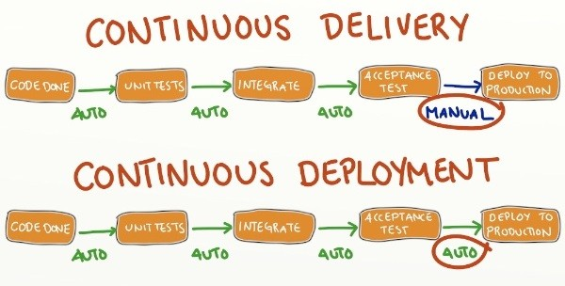
Cont. Delivery to Cont. Deployment

Slide 15
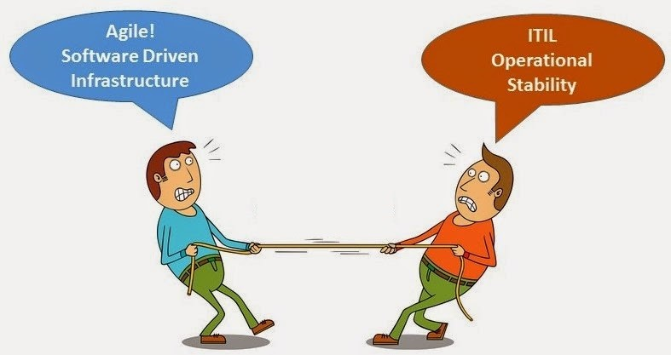
Development Vs Operations
Be more agile
– deliver faster
Change is evil

Slide 16
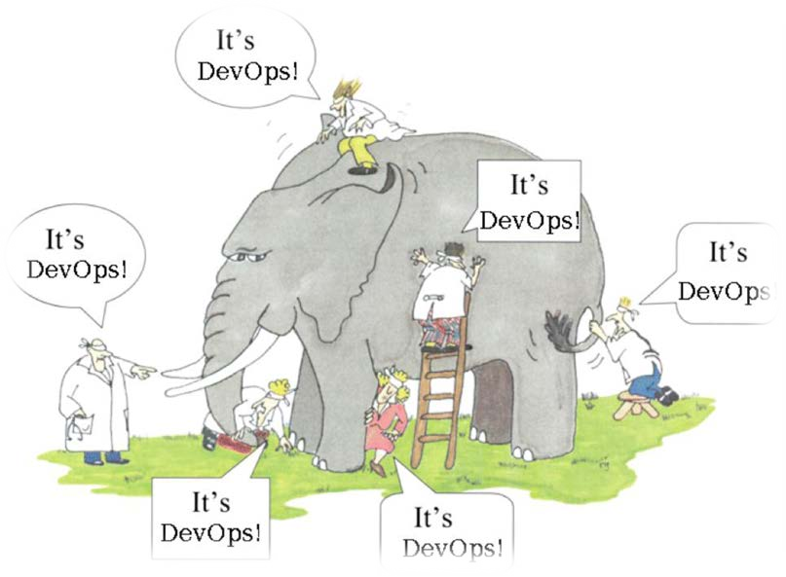
What is DevOps?
Philosophy, movement, a way of thinking
Team of developers and operation staff
Collaboration between Dev and Ops
Process or Framework
Culture movement
Continuous Deployment / Monitoring
Culture Shift and set of principles and methods (based on Agile & Lean) for better Dev & Ops collaboration to build software that meets business needs faster, cheaper & more reliably.

Slide 17
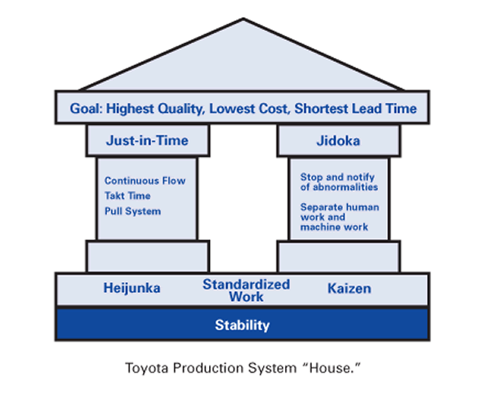
Basics of Lean Software Development
7 Key Principles
 Eliminate Waste
 Build Quality In
 Create Knowledge
 Defer Commitment
 Deliver Fast
 Respect People
 Optimise The Whole
© Copyright 2015-16 Dyaneshwaran Periyasamy

Slide 18
DevOps Values
 Culture
 Automation
 Measurement
 Sharing
© Copyright 2015-16 Dyaneshwaran Periyasamy

Slide 19




Why DevOps?
98,000 tweets
23,148 apps downloaded
Mainframe
400,710 ad requests
Every 60 seconds
Client/Server
2,000 lyrics played on Tunewiki
Internet
1,500 pings sent on PingMe
34,597 people are using Zinio
Mobile, Social, Cloud & Big Data
208,333 minutes Angry Birds played

Slide 20
DevOps Values
DevOps emphasizes people and culture over tools and processes, and seeks to improve collaboration between Operations and Development teams.
Agile & Lean Principles
DevOps embodies Agile and Lean principles. It enables faster delivery of functionality
achieved through Agile and focuses on reducing waste.
Culture
Enables people to work cohesively for common goal. Encourages trust, openness and
ownership; facilitated through frequent communications among relevant teams
Automation
To ensure that automation is not an afterthought; this minimizes human interventions from
day one and makes output consistently repeatable
Measurement
If you can’t measure, you can’t improve. Measure current processes and plan for the improvement
12

Slide 21
State of DevOps Report (2012)
 | Deploy Frequency | Deploy Lead Time
Amazon | 7,500 per day | minutes
Google | 5,500 per day | minutes
Netflix | 500 per day | minutes
Facebook | 1 per day | hours
Twitter | 3 per week | hours
Agility Metrics
30x more frequent code deployments
8000x faster code deployment lead time
Reliability Metrics
2x the change success rate
12x faster Mean Time To Recover (MTTR)

Slide 22
DevOps Objectives
Automation
Quality
Collaboration
Governance
Monitoring

Slide 23
Prerequisites for DevOps Success
 On board Executive Sponsors / Stakeholders
 Create organization’s ‘value’ stream
 Restructure Development and Operations team
 Change performance incentives for Dev and Ops teams
 Standardize processes which can be repeated
 Leverage automation
 Infrastructure as code
 Continuous Integration / Delivery / Deployment / Monitoring
 Capture key metrics
 Change Frequency
 Change Lead Time
 Change Failure Rate
 MTTR

Slide 24
Alignment with the business needs
Don’t Automate What You Don’t Understand!

Slide 25
DevOps Adoption Steps
Formulate DevOps Strategy
Assess maturity of Dev and Ops teams
Adopt the strategy
Measure and continuously improve
© Copyright 2015-16 Dyaneshwaran Periyasamy

Slide 26
DevOps Patterns
Embed project knowledge into operations
Extend delivery to production
DEV
OPS
Extend operations feedback to delivery
Embed operations knowledge into project
© Copyright 2015-16 Dyaneshwaran Periyasamy

Slide 27
Service Quality Metrics
Throughput Measures
Deployment frequency. How frequently the organization deploys code.
Deployment lead time. Time required for changes to go from “code committed” to code successfully running in production.
Stability Measures
Mean time to recover (MTTR). Time required to restore service when a service incident occurs (e.g., unplanned outage, service impairment, etc.).
Success Rate. % of successful deployments out of total deployments
© Copyright 2015-16 Dyaneshwaran Periyasamy

Slide 28
DevOps Automation

Slide 29
AGENDA
 Why Automation?
 Collaborative Lifecycle Management (CLM)
 DevOps Tools
 Continuous Integration (CI) Systems
 System Configuration Automation
 Build and Dependency Management Systems
 Containerization Tools
© Copyright 2015-16 Dyaneshwaran Periyasamy

Slide 30



Why Automation?
Culture
Automation
Measurement Sharing
Lead Time
Lead Time

Slide 31
Collaborative Life Cycle Management
Business
Dev
QA
Ops

Slide 32
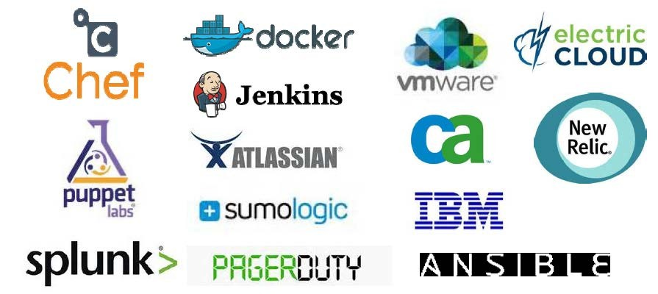

DevOps Tools

Slide 33






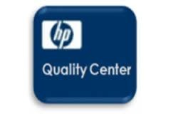
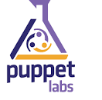

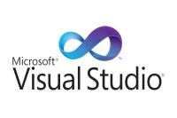














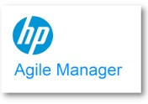



DevOps Tool Chain
Software Lifecycle Management
Dev
Environment
SCM / Version Control
Build Management
Defect Management
Infrastructure Automation
Code Quality
Test Automation
14

Slide 34
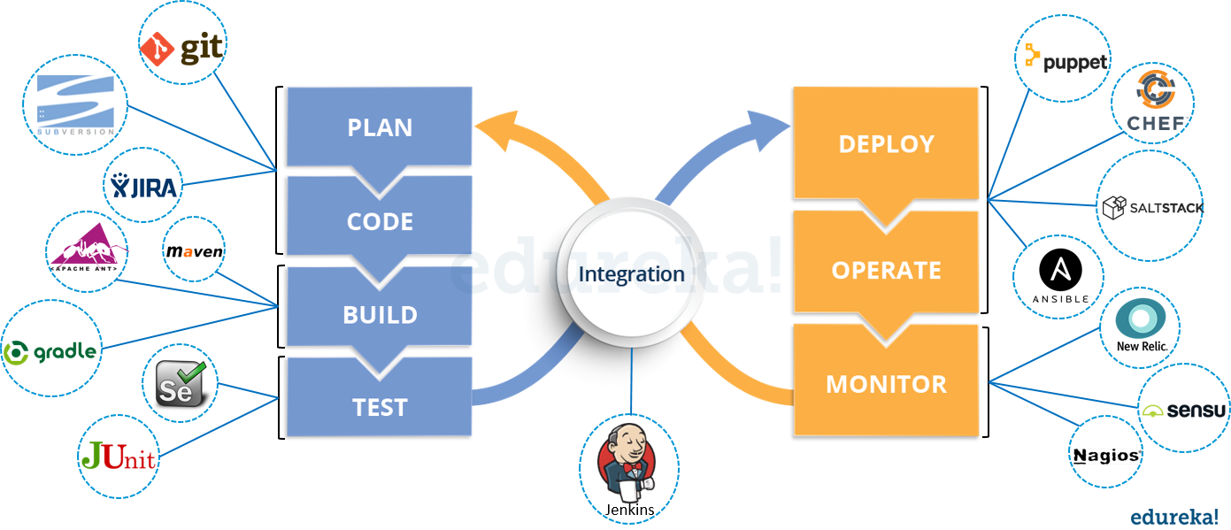
Continuous Integration (CI) Systems

Slide 35




Continuous Integration (CI) Systems
Repository
Notifiers
SVN GIT TFS CVS
Email Web Status Status Client
Changes
Build Master
Status
Commands
Build Slave
Build Slave

Slide 36
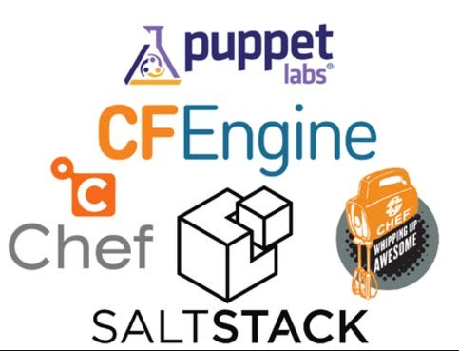
System Configuration Automation
Application
Middleware OS
Server

Slide 37
Build and Dependency Management Systems
Build Automation
 On Demand
 Scheduled
 Triggered
Build Dependencies
Build 1
Build 2
Build 3

Slide 38
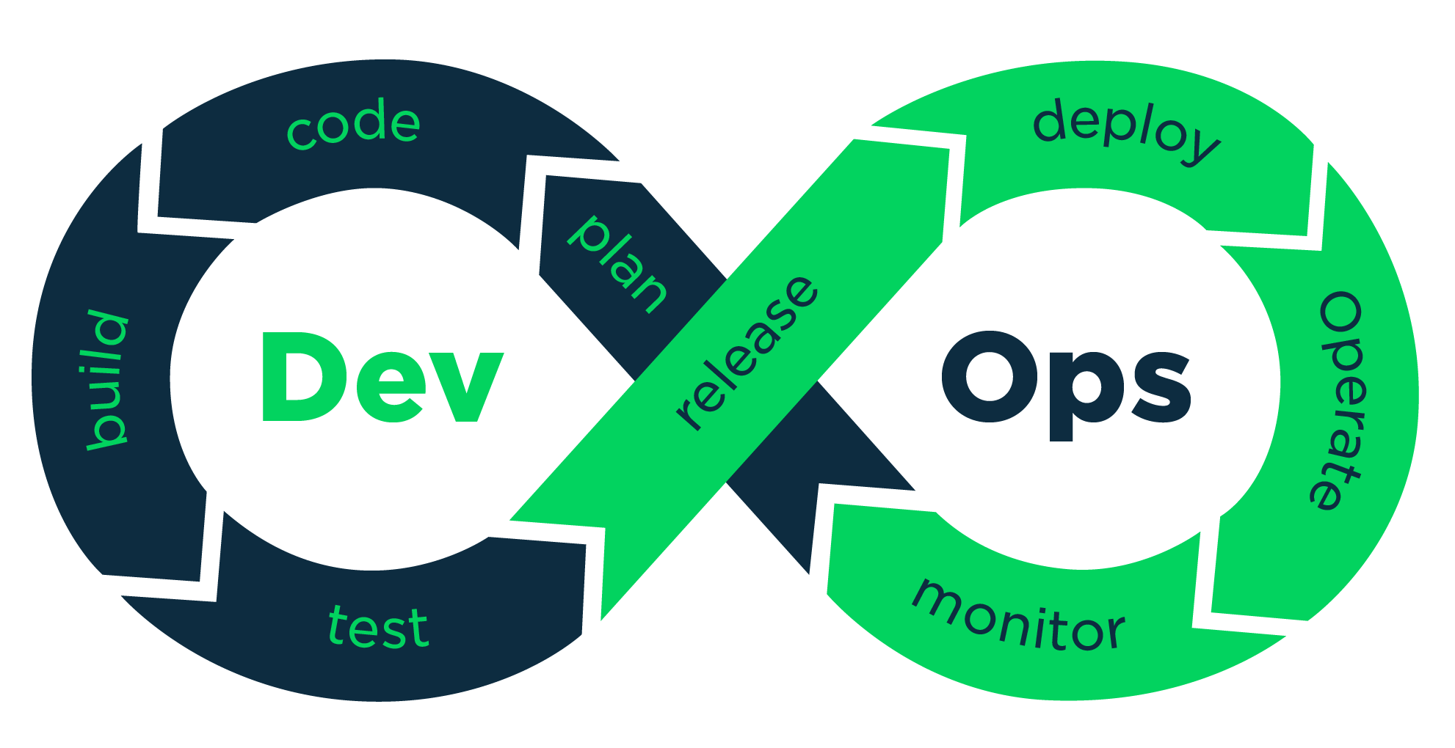
DevOps Process

Slide 39
DevOps Benefits
Product Improvement
Less time taken for production stabilization
Low / controlled defects in the application
Early detection of software issues
Improved quality of deployed applications
Productivity Improvement
Increase in the number of releases and release data adherence
Increased collaboration between business , users and IT (Dev and Ops)
Business Improvement
Accelerate introduction of new functionalities to business
Reduced time to market
Increase in business revenue
13

Slide 40


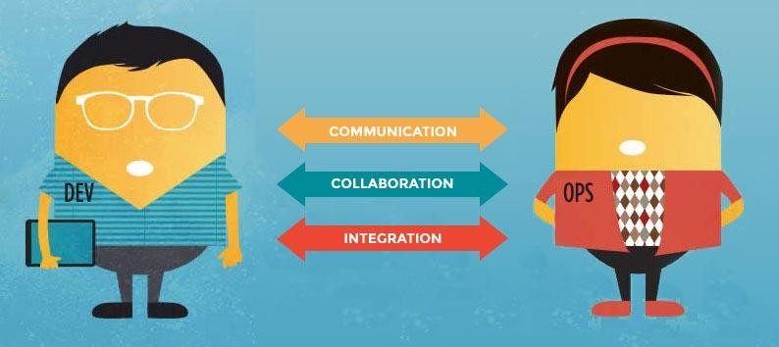
DevOps
Patrick Debois
System administrator
Andrew Shafer
Software developer
Agile Systems Administration Group “DevOpsDays”
11

Slide 41
Thank You

